Slide 1

CUSTOMER CARE REGISTRY
TECHNOLOGY ARCHITECTURE

Slide 2
TEAM MEMBER
TEAM LEADER :PREETHI R
TEAM MEMBER 1 : RAMYA D
TEAM MEMBER 2 :SATHIYAKALA S
TEAM MEMBER 3 SRI VARDHINI K
2

Slide 3
TEAM DETAILS:
Team No College Name Department
: PNT2022TMID10774
: IFET Collage Of Engineering
: Electronics and Communication ngineering
3

Slide 4
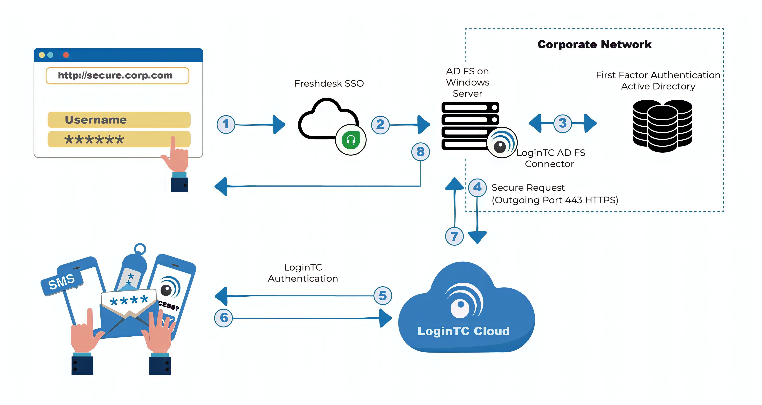
TECHNOLOGY ARCHITECTURE

Slide 5
TECHNOLOGY ARCHITECTURE
S.No. | Components | Description | Technology
1. | User Interface | How user interacts with application e.g. Web UI, Mobile App, Chatbot etc. | HTML, CSS, JavaScript / Angular Js / ReactJs etc.
2. | Freshdesk SSO | Single Sign-On capability | Clouding Authentication
3. | AD FS on Windows Server | To provide users with single sign-on access to systems | Firewall
4. | Login AD FS TC Connector | Toenable active Directory Federation Services to add multi-factor authentication | Authentication
5. | HTTP | Data exchange on the Web and it is a client-server protoco | IP datagram
6. | Login TC Cloud | Database service on cloud | Local Cloud Storage

Slide 6
APPLICATION CHARACTERISTICS
S.No. | Characteristics | Description | Technology
1. | Open-source framework | List the open-source frameworks used | Python flask
2. | Security Implementation | List all the security / access controls implemented, use of firewalls etc. | e.g., encryption, intrusion detection software,antivirus, firewalls
3. | Scalable Architecture | Justify the scalability of architecture. | Supports higher workloads without any fundamental changes to it.
4. | Availability | Justify the availability of application. | High availability enables your IT infrastructure to continue functioning component
5. | Performance | Design consideration for the performance of the application. | Performance technology, therefore, that uses various tools, processes, and ideas individuals and organizations.

Slide 7

THANK YOU!!..

